Slide 1
Teaching Automata Theory and Formal Languages with Dafny R. Ettinger Dafny 2026 January 11, 2026 | POPL | Rennes, France

Slide 2
The Traditional Challenge
Traditional Automata Theory Courses:
📚 Abstract mathematical definitions on paper
✏️ Hand-drawn state diagrams
📝 Manual execution traces
❓ “Does my machine actually work?”
Student Experience:
Errors discovered days later (after submission)
Debugging on paper is tedious and error-prone

Slide 3
Dafny to the Rescue
What if students could:
✅ Run their automata on test inputs?
✅ Debug with immediate feedback?
✅ Verify correctness formally?
✅ Understand through hands-on implementation?
Answer: Use Dafny!

Slide 4
My Formal Methods Journey
Corret-by-Construction Program Transformation Algorithms [Oxford University, 2001-2006]
My doctoral thesis
Calculational proofs (on paper) via assertion propagation
Based on Dijkstra and Scholten’s Predicate Calculus and Program Semantics
Teaching with Dafny
Assertive Programming (some Ada/SPARK too)
Ben-Gurion University of the Negev (BGU) [2013-2024]
AFEKA Academic College of Engineering in Tel-Aviv [2016-2021]
Academic College of Tel Aviv – Yaffo (MTA) [2013-2015]
Logic and Set Theory
Ramat Gan Academic College (RGAC) [2021-2024]
This talk: Automata Theory and Formal Languages
RGAC [Fall 2021, Spring 2023]
AFEKA [Summer 2020]
Formal Verification of Firmware and Software [NVIDIA, since Dec. 2020]
Model Checking and Deductive Verification
Sequential and Concurrent code
Languages: C , C++, Ada/SPARK

Slide 5

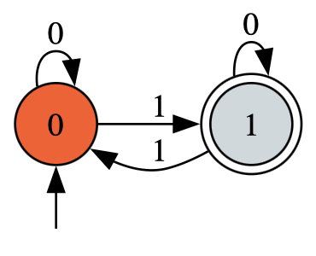
From Math to Verifiable Executable Code
Strictly follow the Textbook by Elaine Rich
Formulated substantial portions in Dafny
This talk’s focus: DFSMs
Deterministic Finite State Machines

Slide 6
Deterministic Finite State Machines (DFSMs): Deep Dive

Slide 7
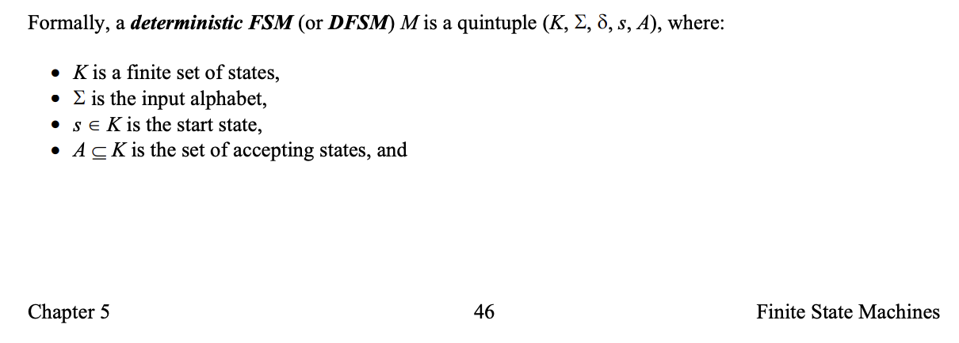
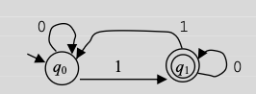
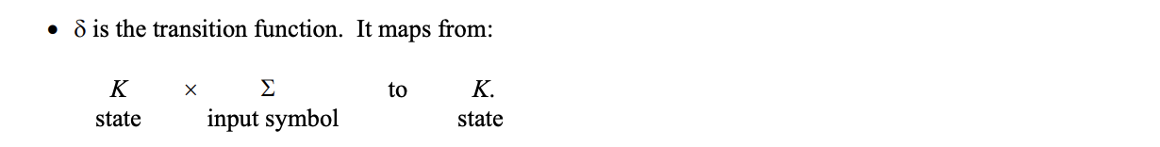
Traditional Definition (Textbook)
Notes:
Notes:
The delta bullet is cut from the top of Page 47
The drawing is from Example 5.4: top of page 49

Slide 8
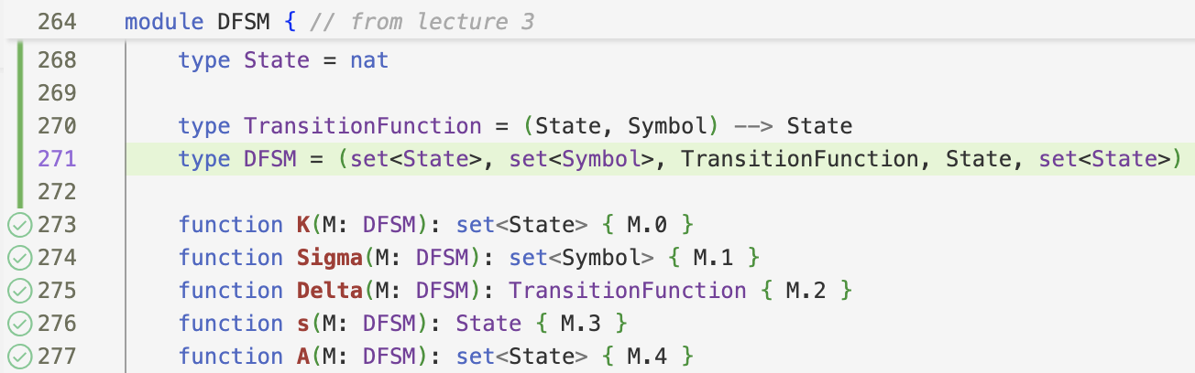
An Executable Definition in Dafny

Slide 9
Example DFSM: Checking for Odd Parity
Language: Binary strings with odd number of 1s
Machine:
DEMO: DFSM Visualizer on “10011”

Slide 10
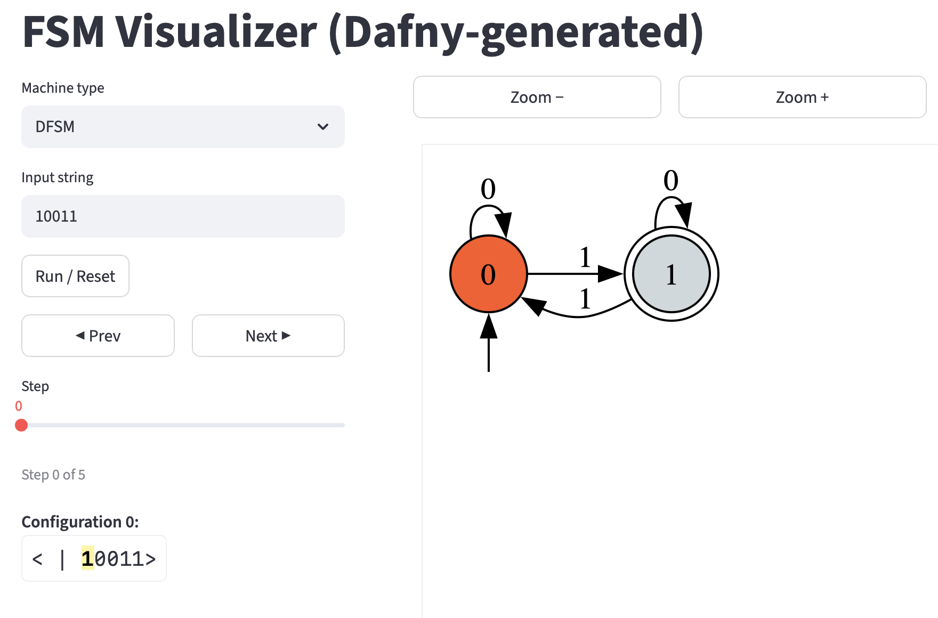

Slide 11
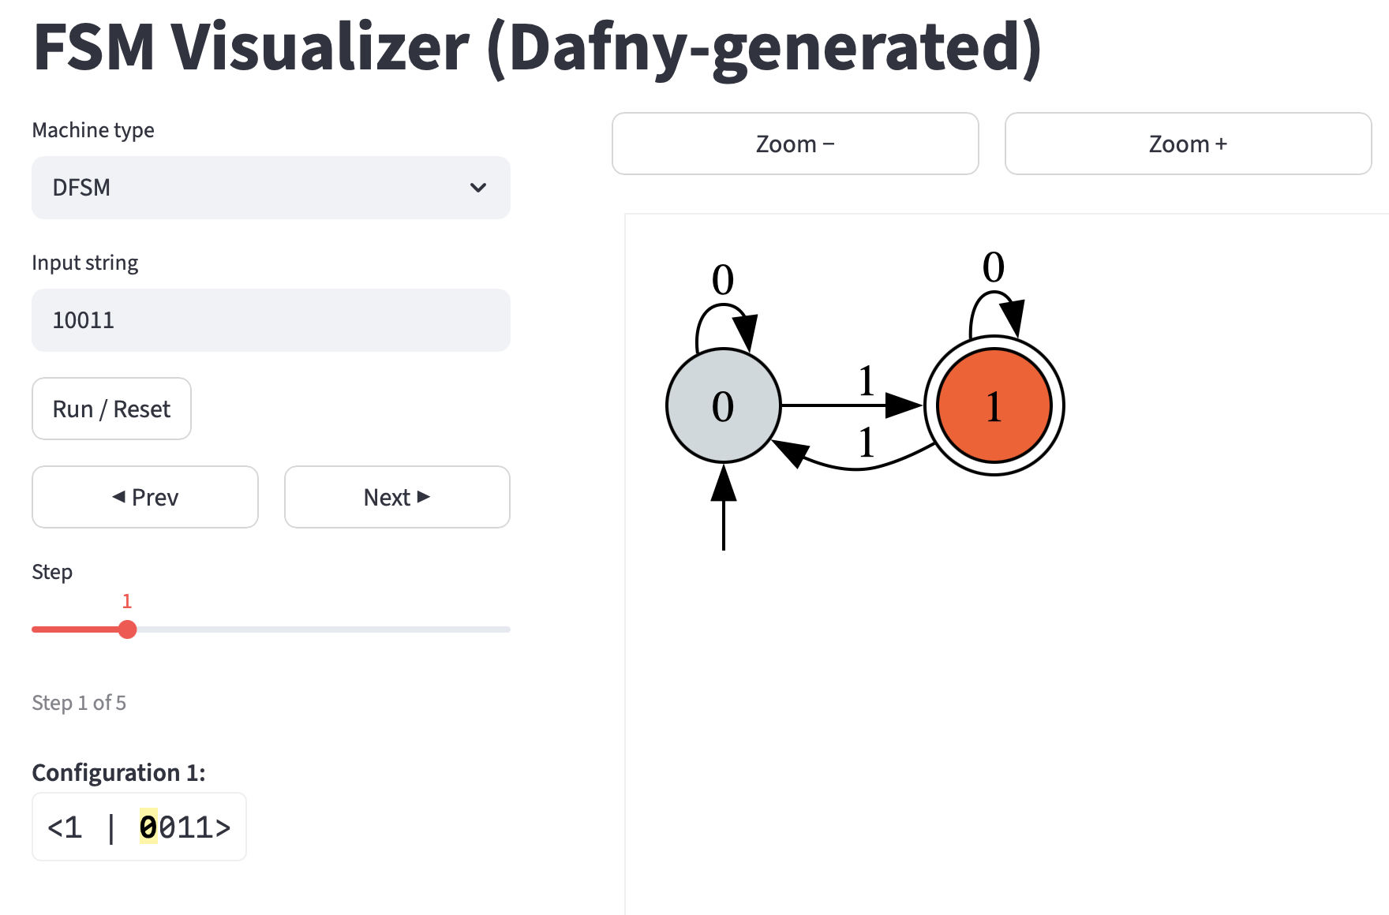

Slide 12
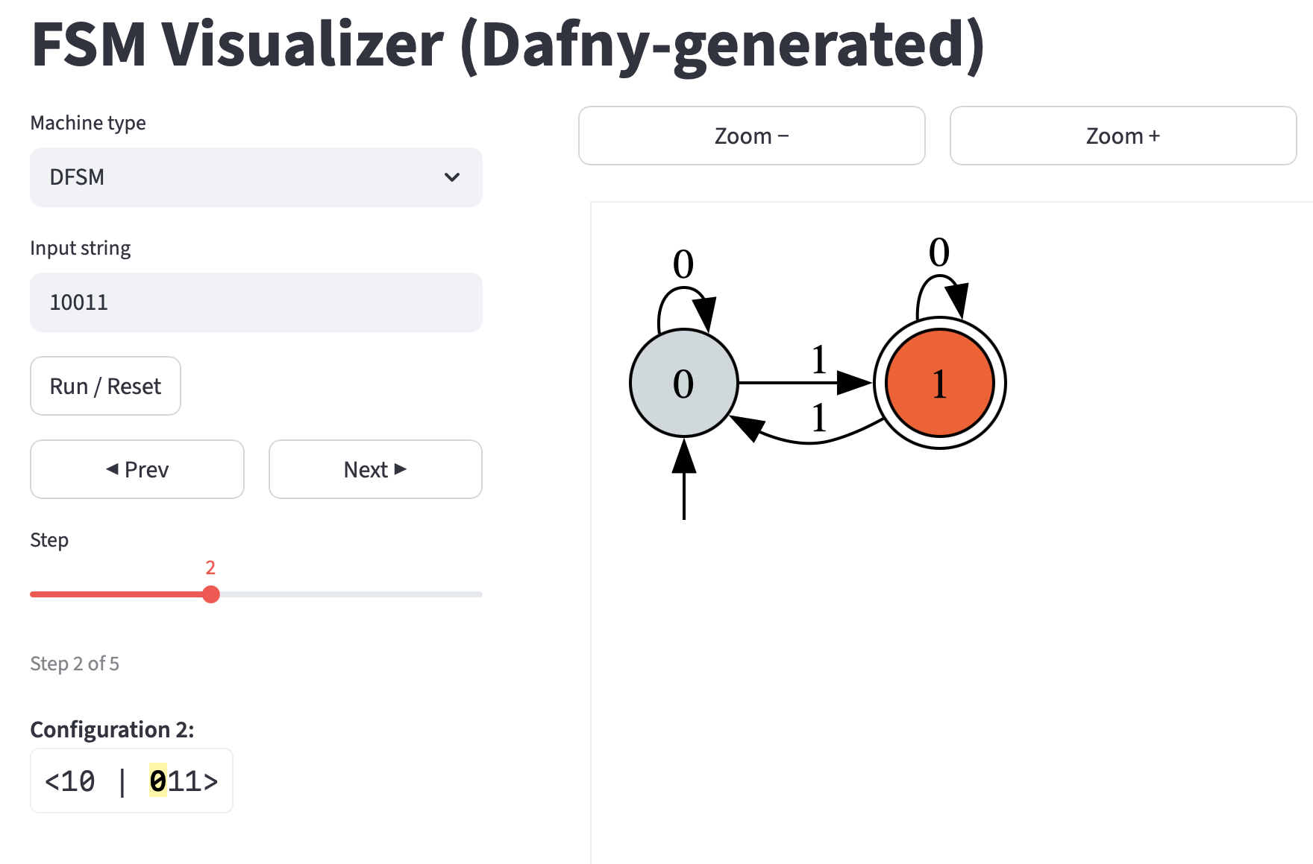

Slide 13
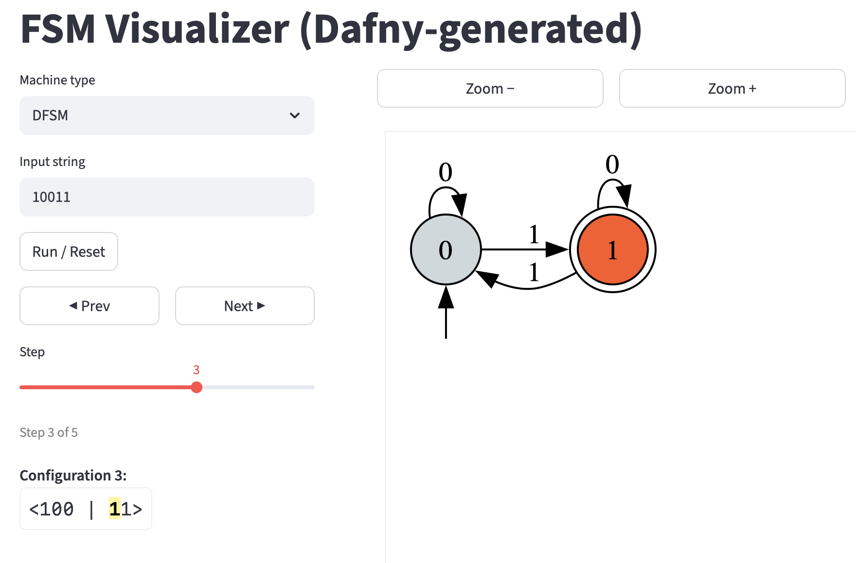

Slide 14
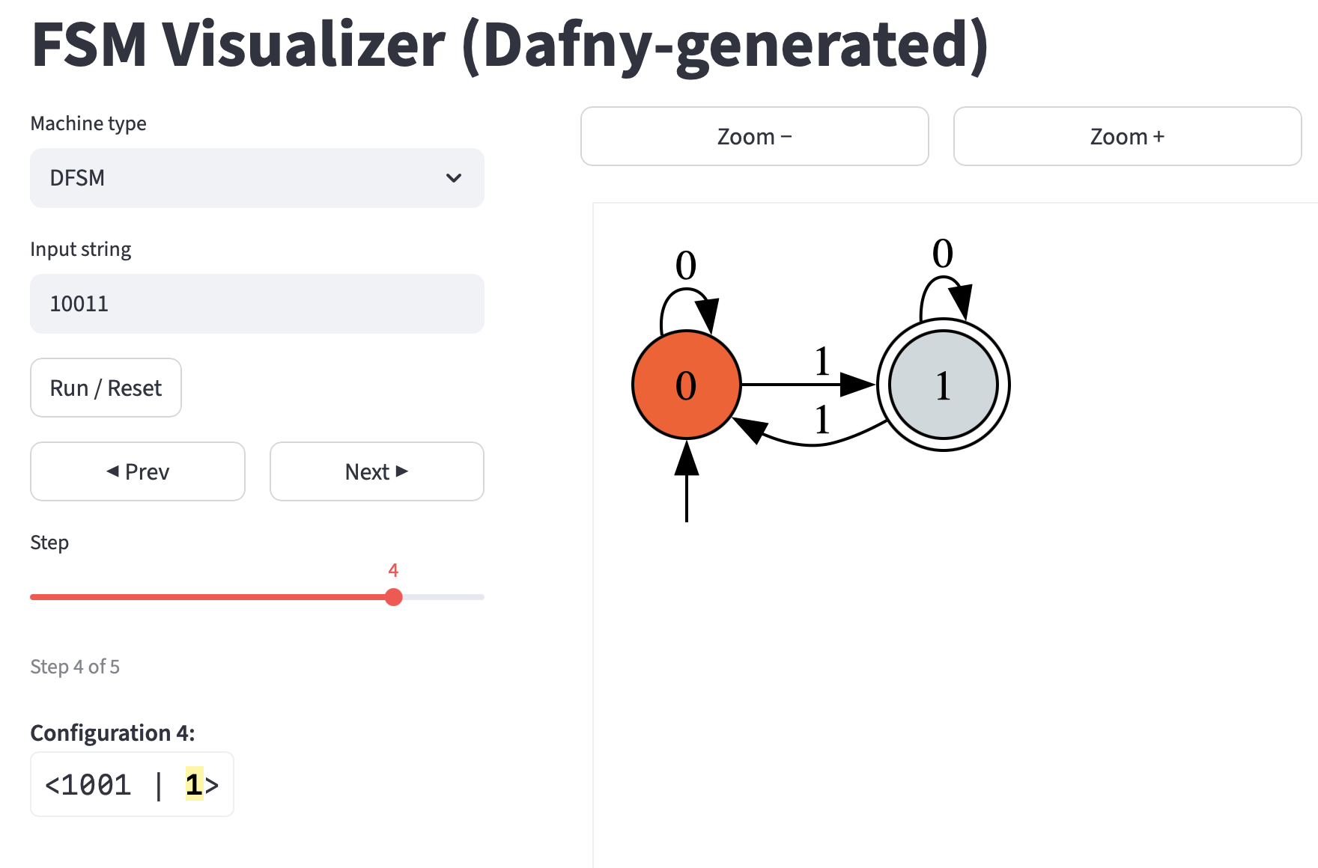

Slide 15
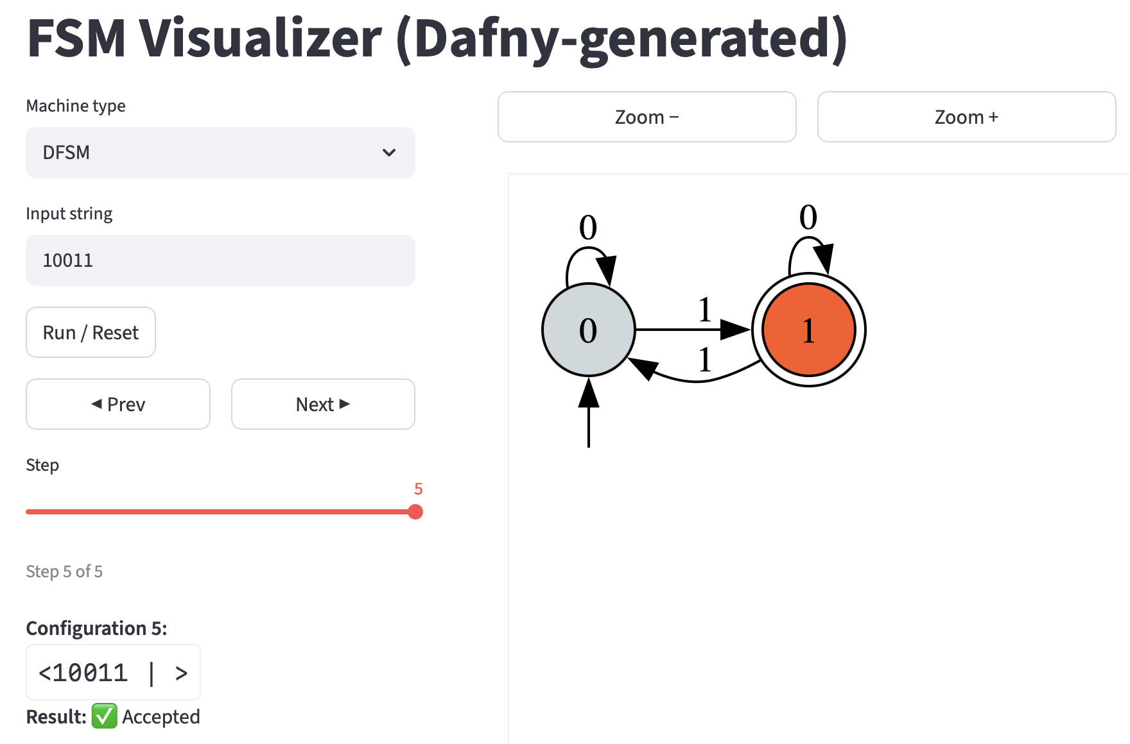

Slide 16
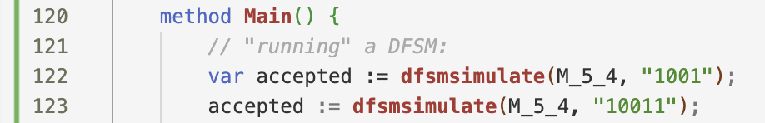
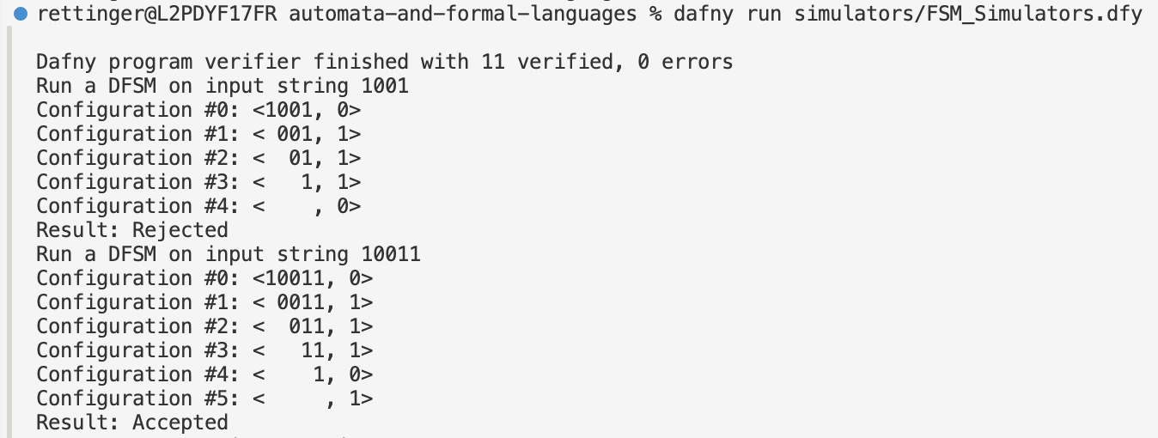
Test on Selected Input Strings
Notes:
What is M_5_4? How is it defined?

Slide 17
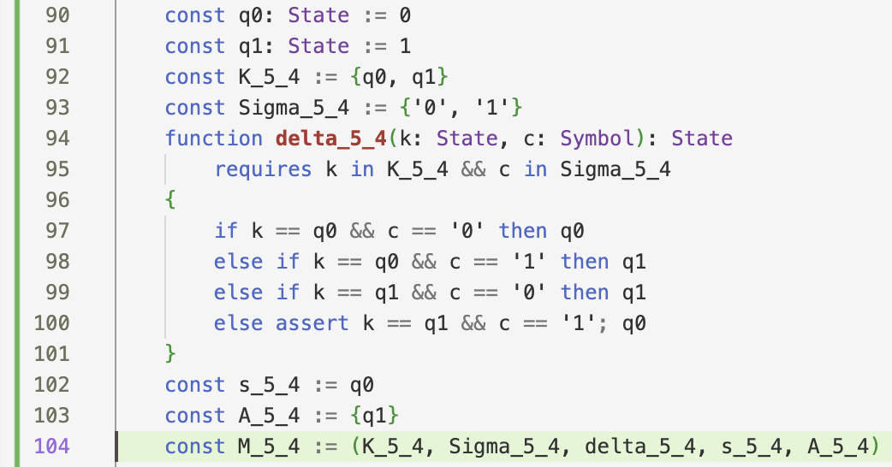
Example 5.4: Machine Definition
Notes:
Okay, that’s a relatively trivial move, using Dafny’s built-in support for tuples, finite sets, and functions (with precondition) as data.
What’s the definition of the State and Symbol types? State we saw earlier; and Symbol?

Slide 18
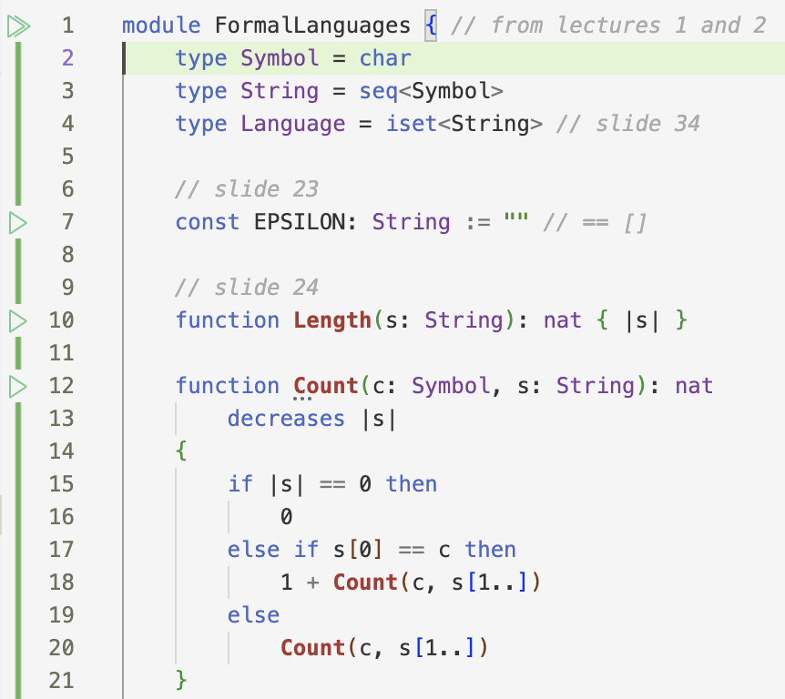
Basic Definitions: Languages as Infinite Sets of Strings
Notes:
Symbol is a char. Simple enough (such that a string is Dafny’s string: a sequence of char elements with the special “” syntax supported too).
Now what about correctness? Can test it (as we did).
More interesting to prove! But before we do that, here’s a separate question:
How is the dfsmsimulate simulator defined?

Slide 19
Language for Example 5.4
Mathematical Specification:
L_5_4 = {w ∈ {0,1}* | w has odd number of 1s}
Dafny Specification:

Slide 20
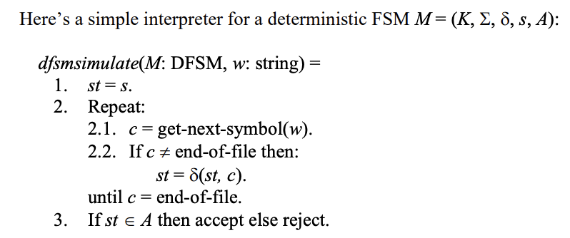
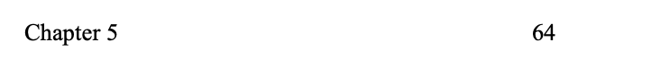
Textbook Simulator
Notes:
And in Dafny?

Slide 21
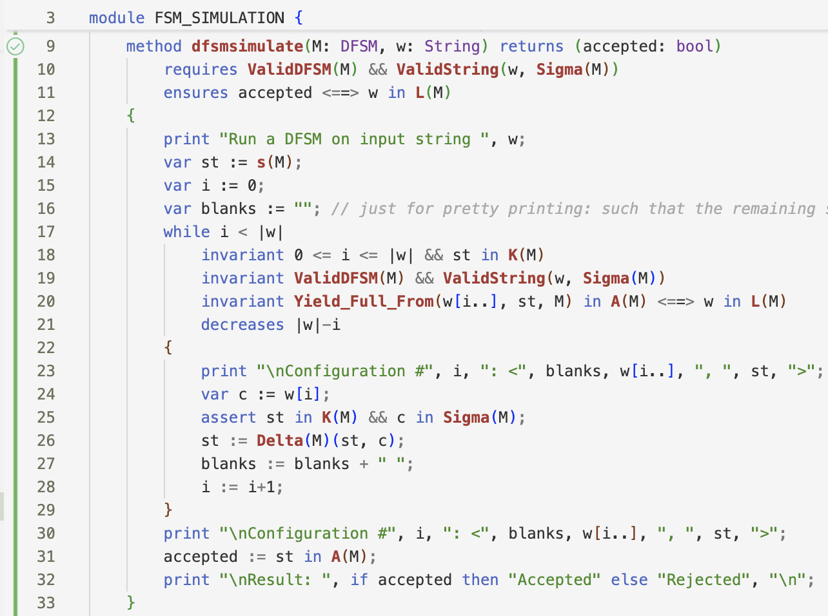
DFSM Simulation
Notes:
Executable simulator/interpreter with correctness guarantee: Students run simulators knowing they’re correct!

Slide 22
DFSM Simulation
Notes:
Beyond the textbook formulation: we print configurations and the acceptance result [as witnessed earlier when running Main]

Slide 23
DFSM Simulation
Notes:
Beyond the textbook formulation, we have a contract: precondition that the machine and input string are valid; postcondition that the the string is accepted iff it is in the language accepted by the machine
we have a proof that the postcondition holds (via loop invariants)
Before we prove correctness, let’s see:
- What are valid DFSMs and strings?
What does it mean for an input string to be accepted by a machine?
How is L(M) defined?

Slide 24
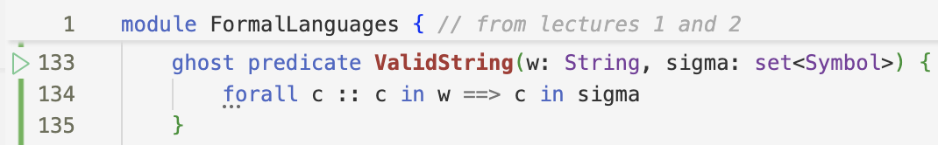
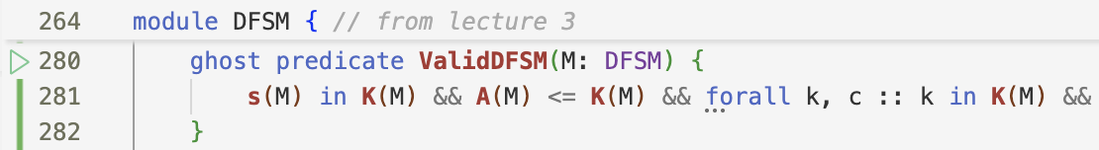



For the Precondition

Slide 25
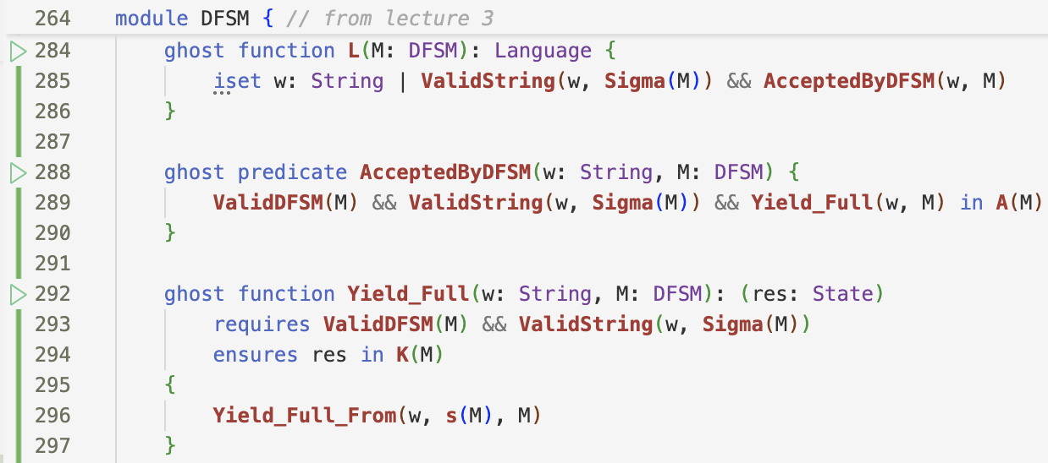
For the Postcondition

Slide 26
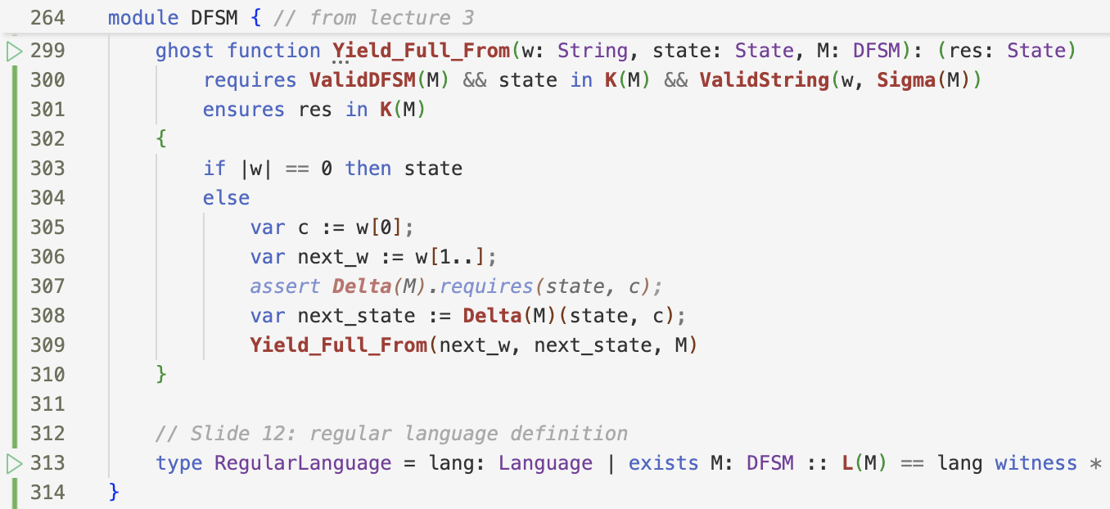
For the Postcondition (cont.)
Notes:
[Bonus definition on line 313 :)]
Now we’re ready to see the fully verified simulator

Slide 27
DFSM Simulation
Notes:
Beyond the textbook formulation: Now we have a full proof that the postcondition holds (via the assertion + loop invariants).
This is an executable simulator/interpreter with a correctness guarantee: Students run simulators knowing they’re correct!

Slide 28
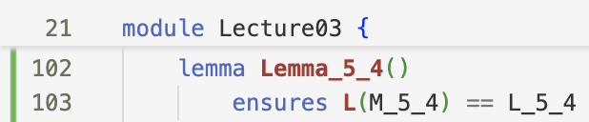
The Machine Correctness Question
We have:
- Machine M_5_4 (implementation)
- Language L_5_4 (specification)
Question: Does M_5_4 accept exactly L_5_4?
In Dafny:
lemma Lemma_16() ensures L(M_16) == L_16
This is what we’ll prove! (formally, auto-actively)
Notes:
Now that we know the simulator is correct and we saw the definition of a language accepted by a DFSM, we’re ready to see a proof of correctness of M_5_4
with its designated lemma per state
mutual recursion / induction
calc construct
forall statement
assert … by
local variables
if/else conditional statements
function calls (on delta(M), to get the next state)

Slide 29
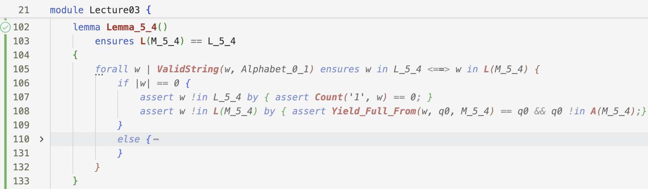
Base Case: An Empty String

Slide 30
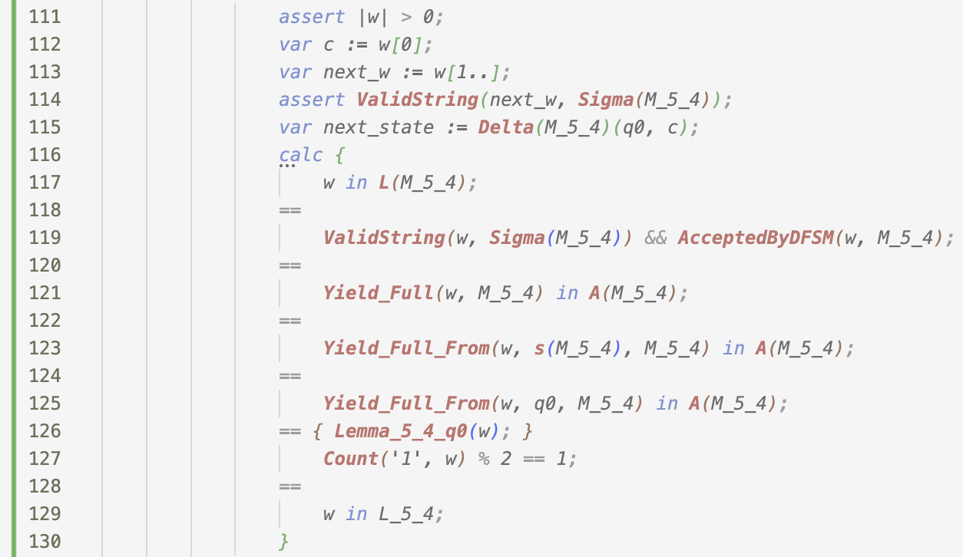
General Case: A Non-Empty String
Notes:
General Case: A Non-Empty String

Slide 31
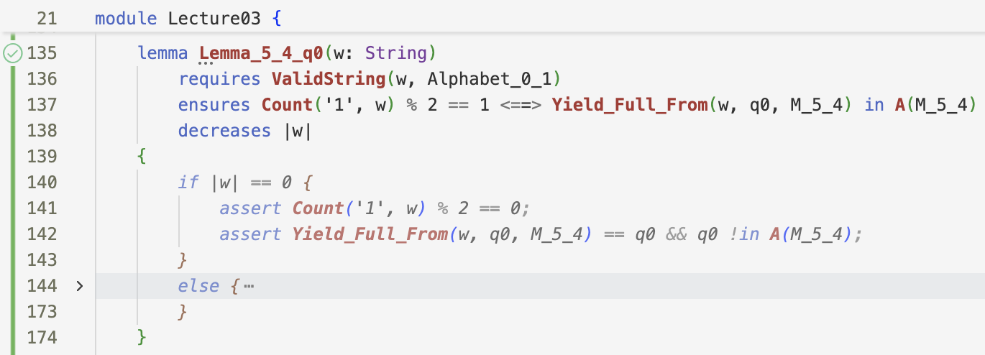
Lemma for q₀: An Empty String
Notes:
Mutual recursion: Lemmas call each other following transitions!

Slide 32
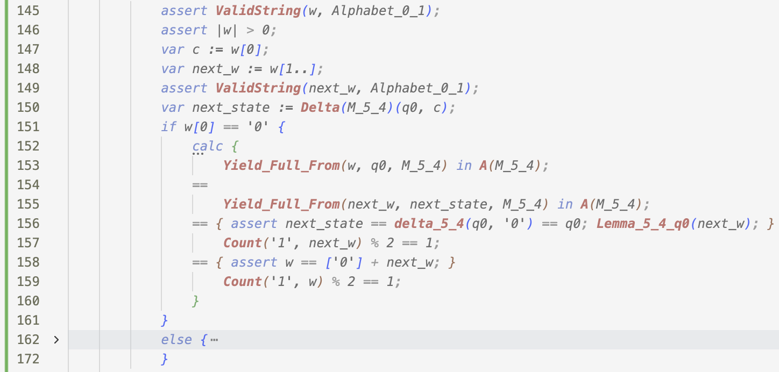
Lemma for state q₀: A Non-Empty String on ‘0’

Slide 33
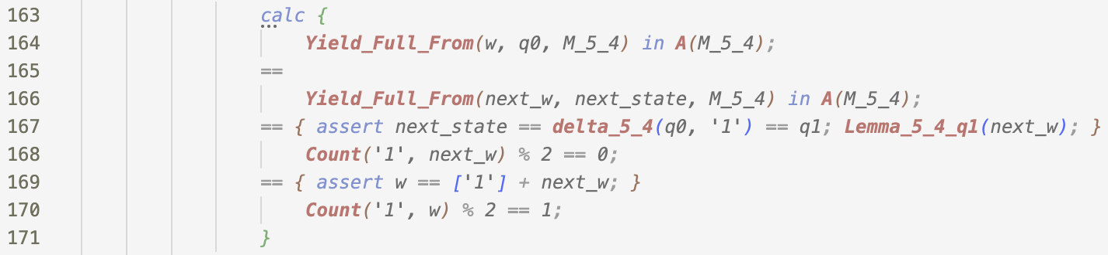
Lemma for state q₀: A Non-Empty String on ‘1’

Slide 34
Proof Structure for the Correctness of a DFSM
By induction on the size of the input string
Lemma for each state
Mutually recursive
Proof follows the machine’s transition function
Main proof “calls” the lemma of the machine’s start state

Slide 35
Deterministic FSM Summary
Semantics of a DFSM is formally defined
DFSM interpreter fully proved
Students can test and prove correctness of their DFSMs

Slide 36
Result: Students see theory come alive!

Slide 37
Course Scope & Ecosystem

Slide 38
What’s Included
Fully Formalized:
Strings, languages, basic operations
DFSMs with complete correctness proofs (M_5_4!)
NDFSMs with epsilon-closure
Partially Verified:
Pumping Lemma for Regular Languages (some helper lemmas unverified)
Regular expressions and Kleene’s theorem
CFGs with derivation generators
PDAs with nondeterministic simulators
Turing machines with operational semantics
Advanced algorithms (construction proofs incomplete)
Tools:
Simulators for all automaton types (in Dafny)
Web visualizers (Dafny → Python → Streamlit)
Potential: Automated testing for assignment submissions evaluation

Slide 39
What’s NOT Covered [with Dafny]
Not Included:
Parsers and parsing algorithms
Decidability formalization
Complete verification of all algorithms
Many advanced proofs
Honest Assessment:
Full verification requires expertise beyond 2nd-year undergrads
Some proofs serve as examples, not requirements
Focus on learning through doing, proofs as bonus

Slide 40
Conclusion

Slide 41
Key Takeaways
Dafny transforms automata theory education:
Abstract → Concrete
Executable (imperative+declarative+functional) code
Immediate feedback
Complete Auto-Active Verification Possible
FSMs (like the M_5_4 example) fully proven
No logical gaps, checked by the machine
Students Learn by Doing
Implement, test, debug, understand
Optional proofs deepen understanding

Slide 42
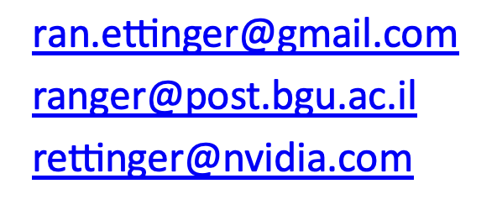
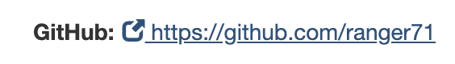
Thanks!
For more info please reach out to me:

Slide 43
Backup Slides

Slide 44
Backup: Assignment Examples
Assignment 1 (Chapter 5): DFSMs
Binary strings where every ‘a’ has ‘b’ before and after
Strings with neither “ab” nor “bb” substring
Binary numbers divisible by 3
Assignment 1 (Chapter 6): NDFSMs
Strings containing “aa” or “bb”
Third-to-last symbol is ‘1’
Manually trace epsilon-closure
Assignment 2 (Chapter 11): CFGs
Balanced parentheses (multiple types)
Palindromes - {a^i b^j | 2i = 3j + 1}
Assignment 2 (Chapter 12): PDAs
Same languages as CFG assignment
Test with simulator

Slide 45
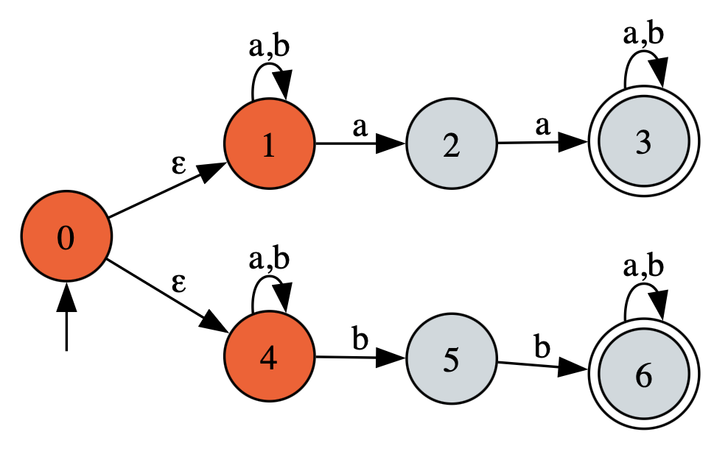
Example NDFSM: Strings containing “aa” or “bb”

Slide 46
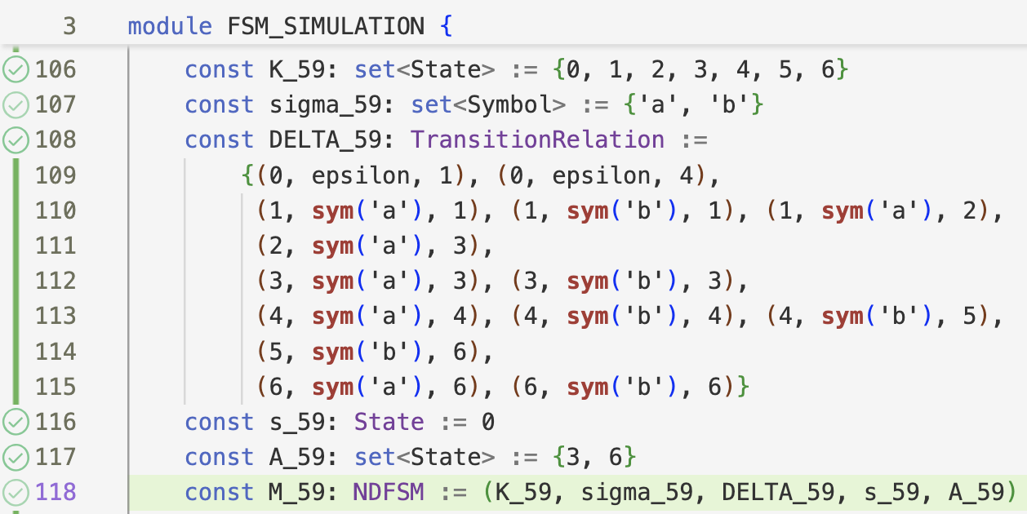

Slide 47
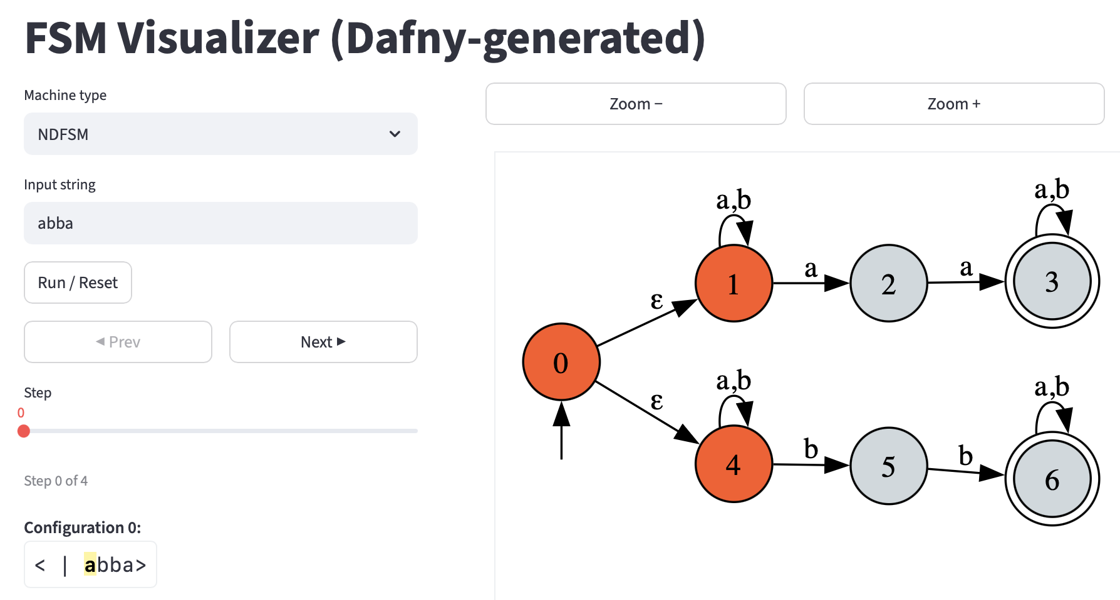

Slide 48
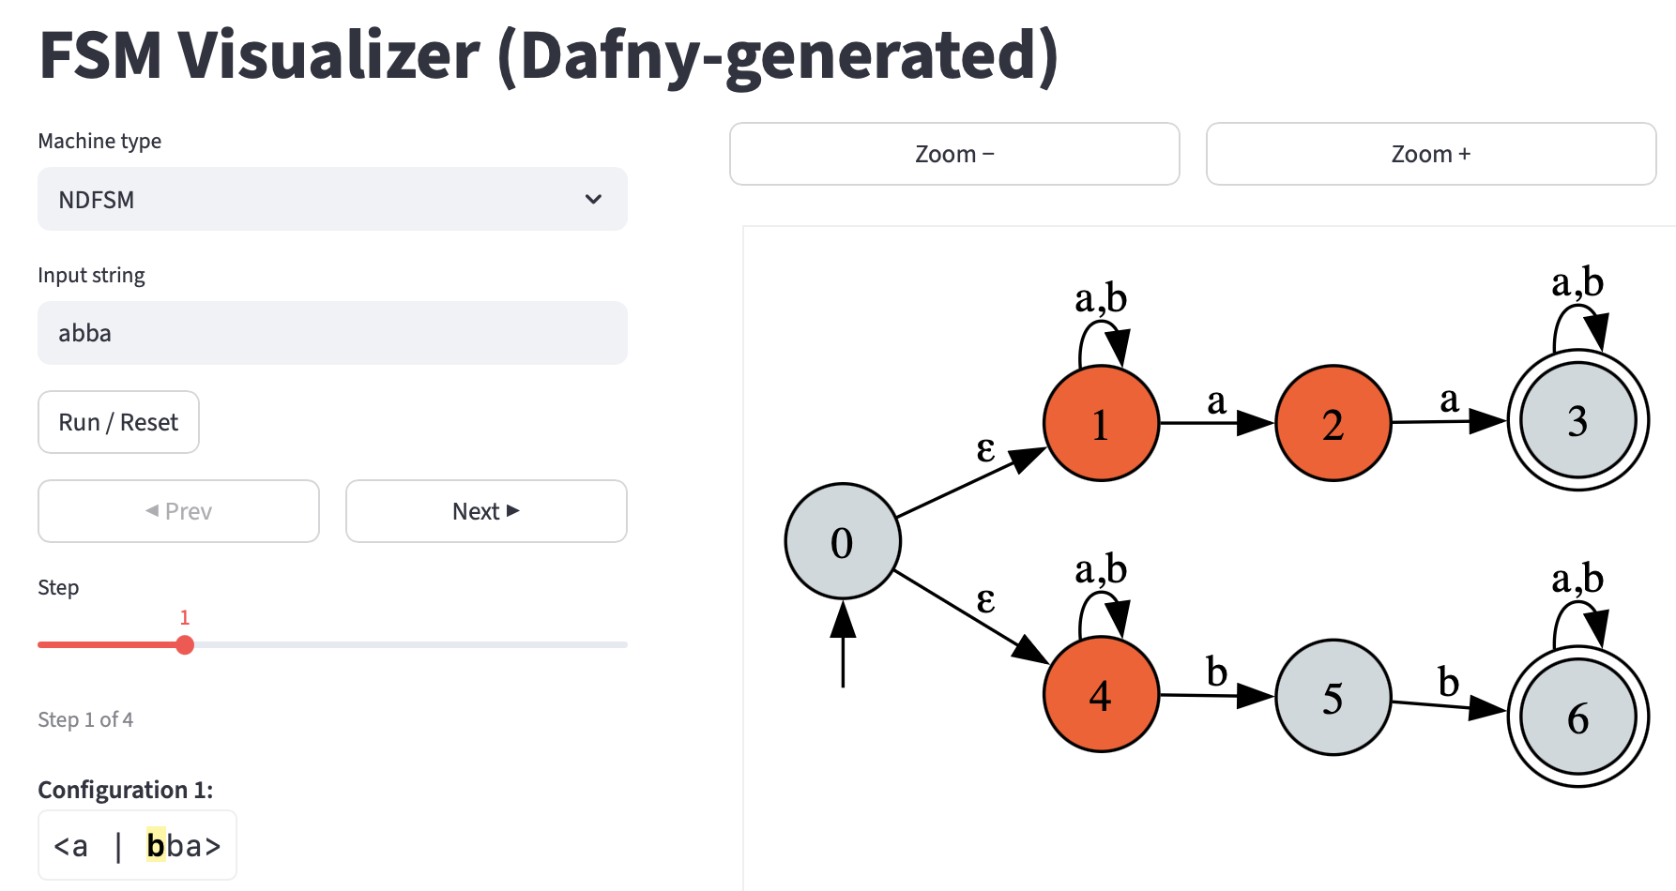

Slide 49
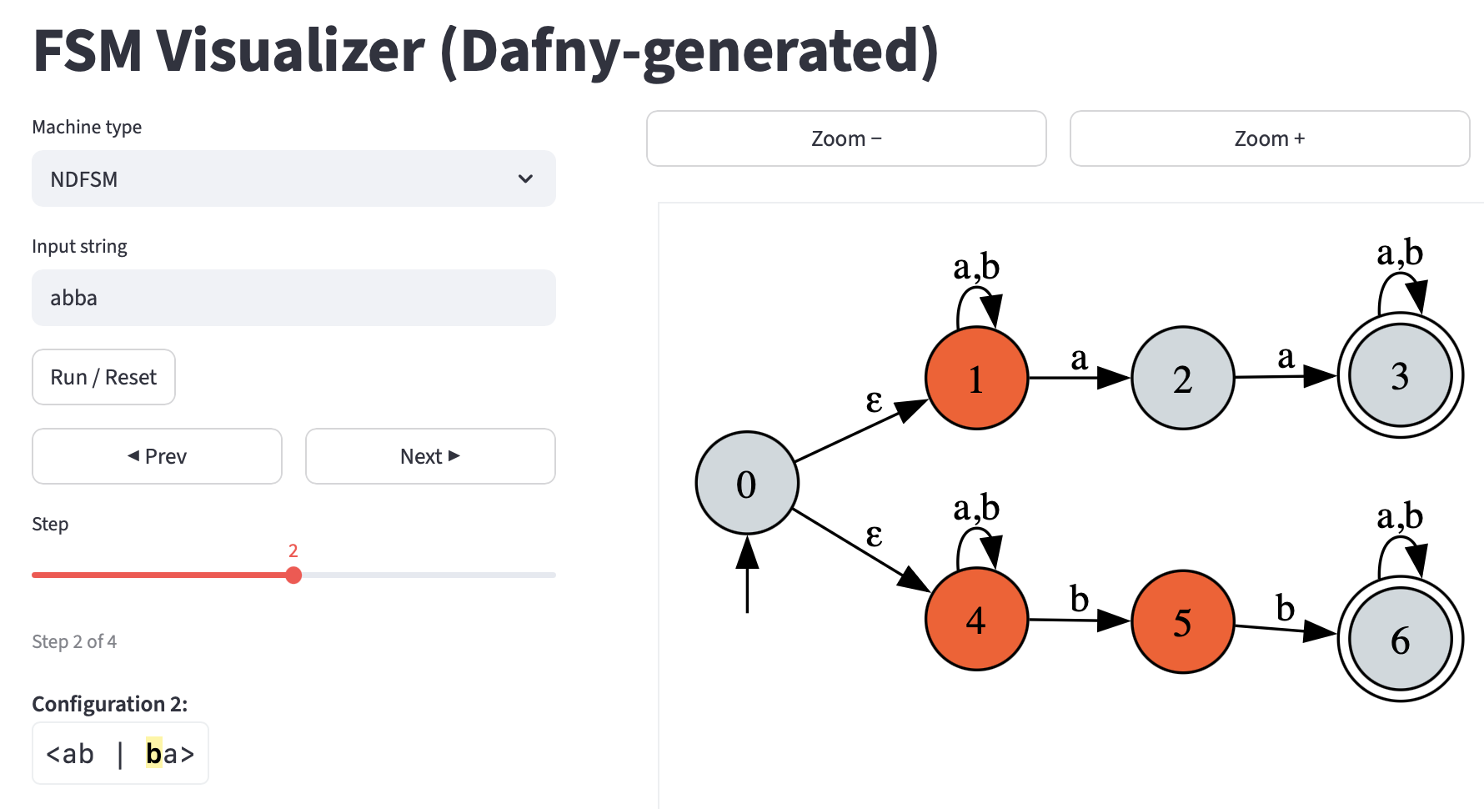

Slide 50
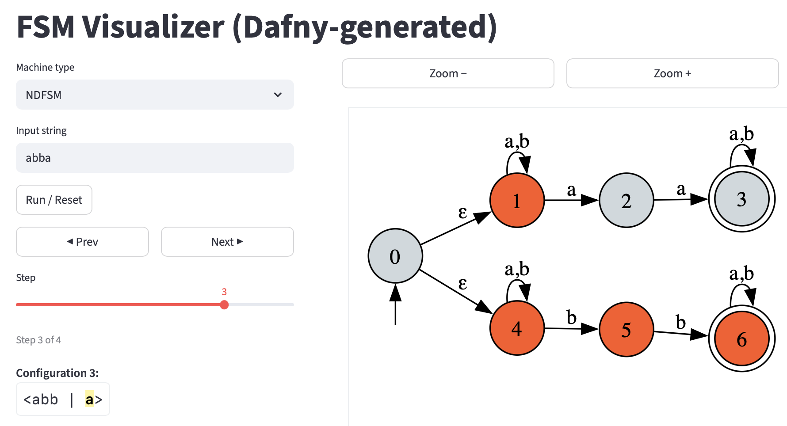

Slide 51
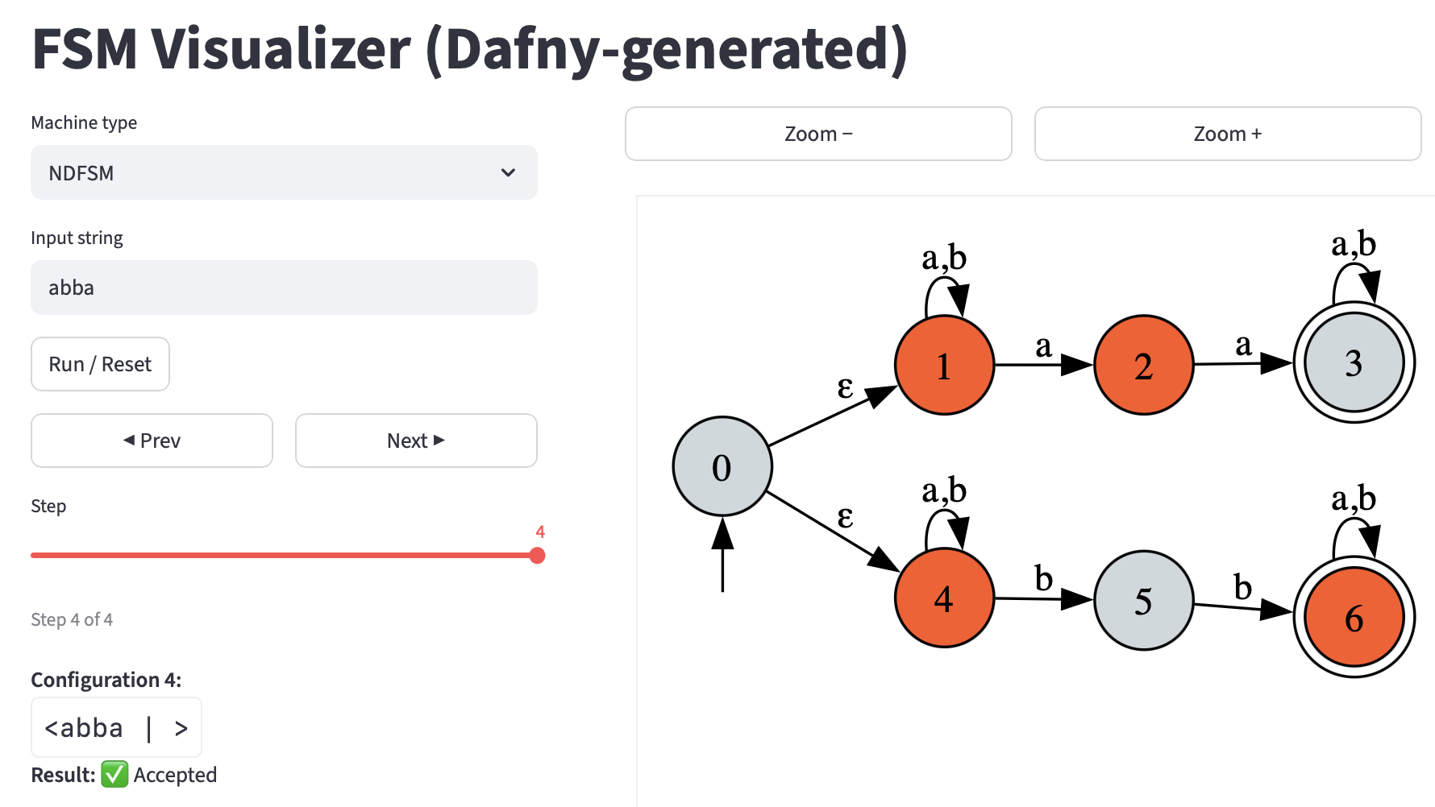

Slide 52
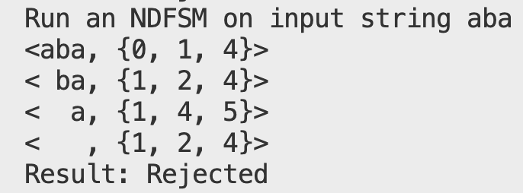
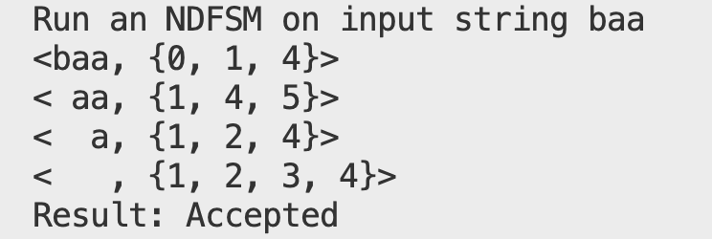
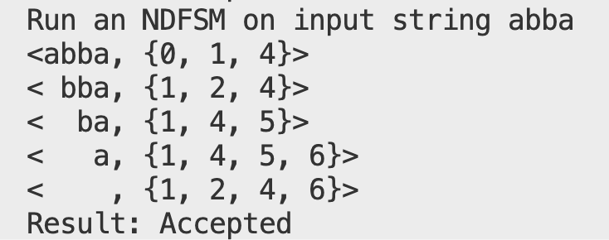

Slide 53
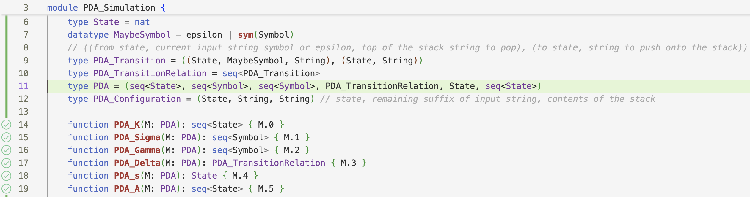

Slide 54
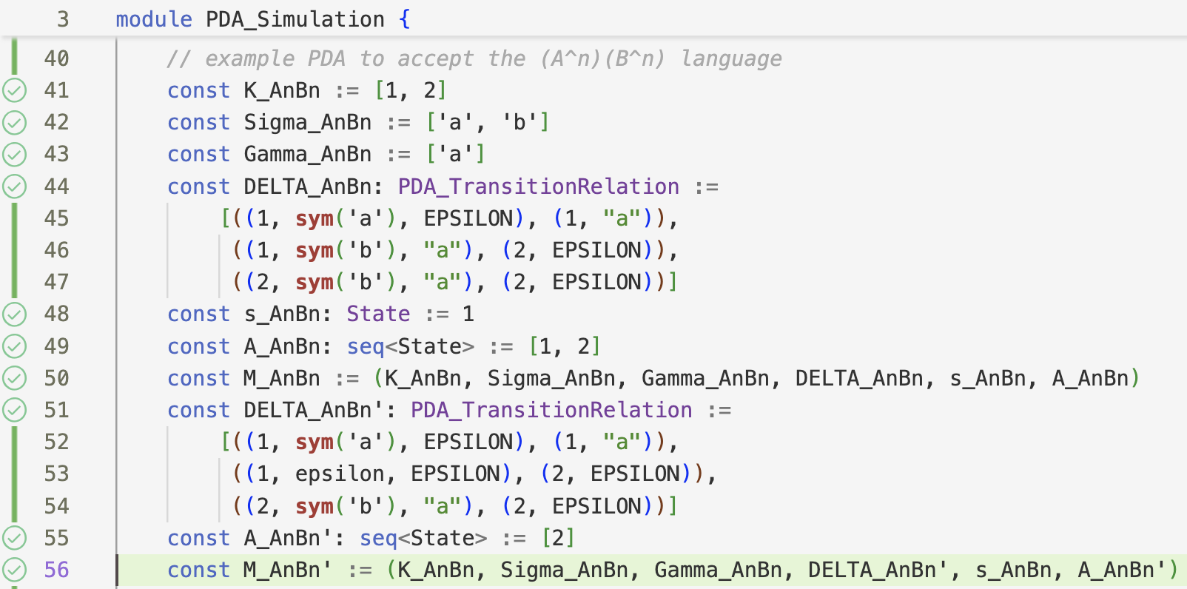

Slide 55
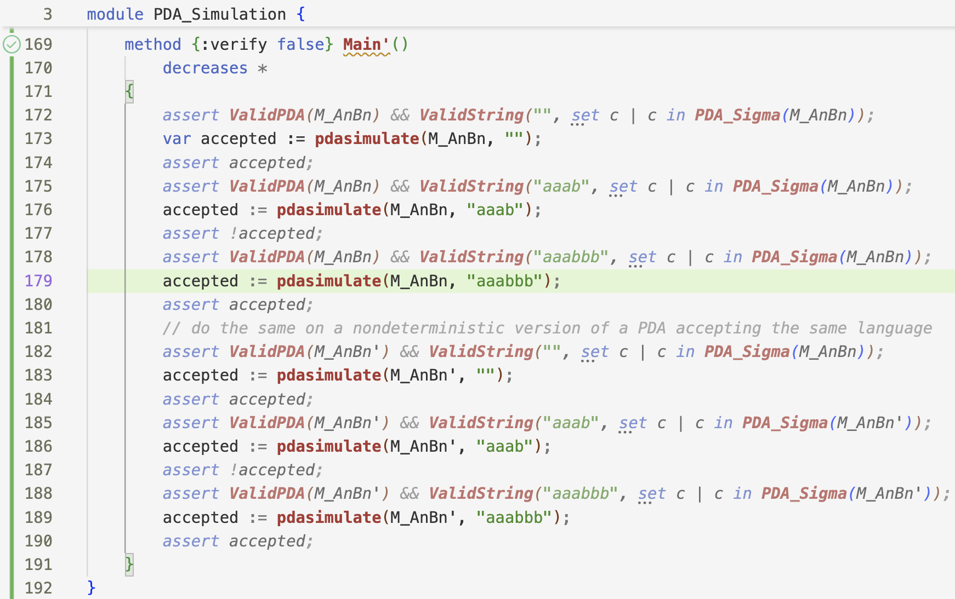

Slide 56
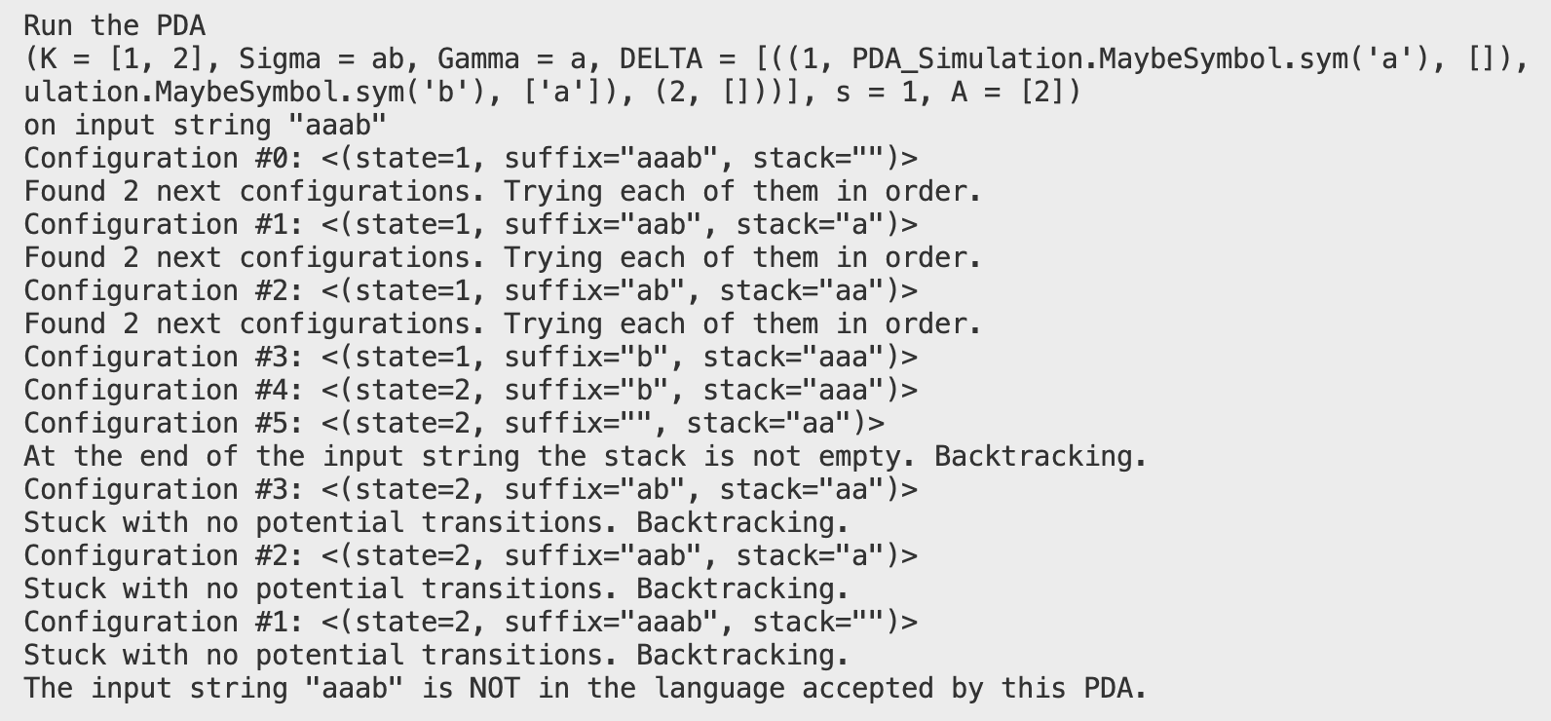

Slide 57
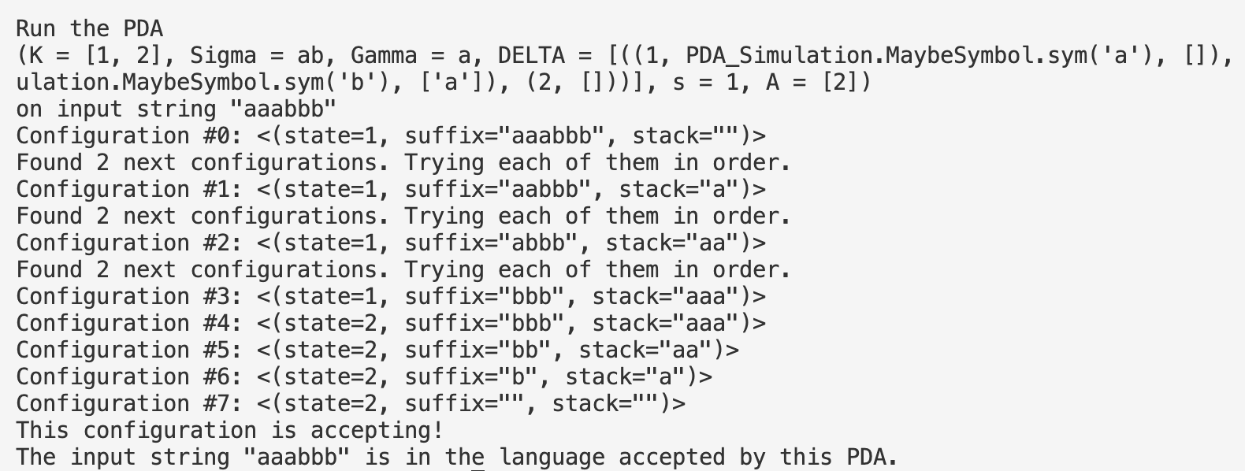

Slide 58
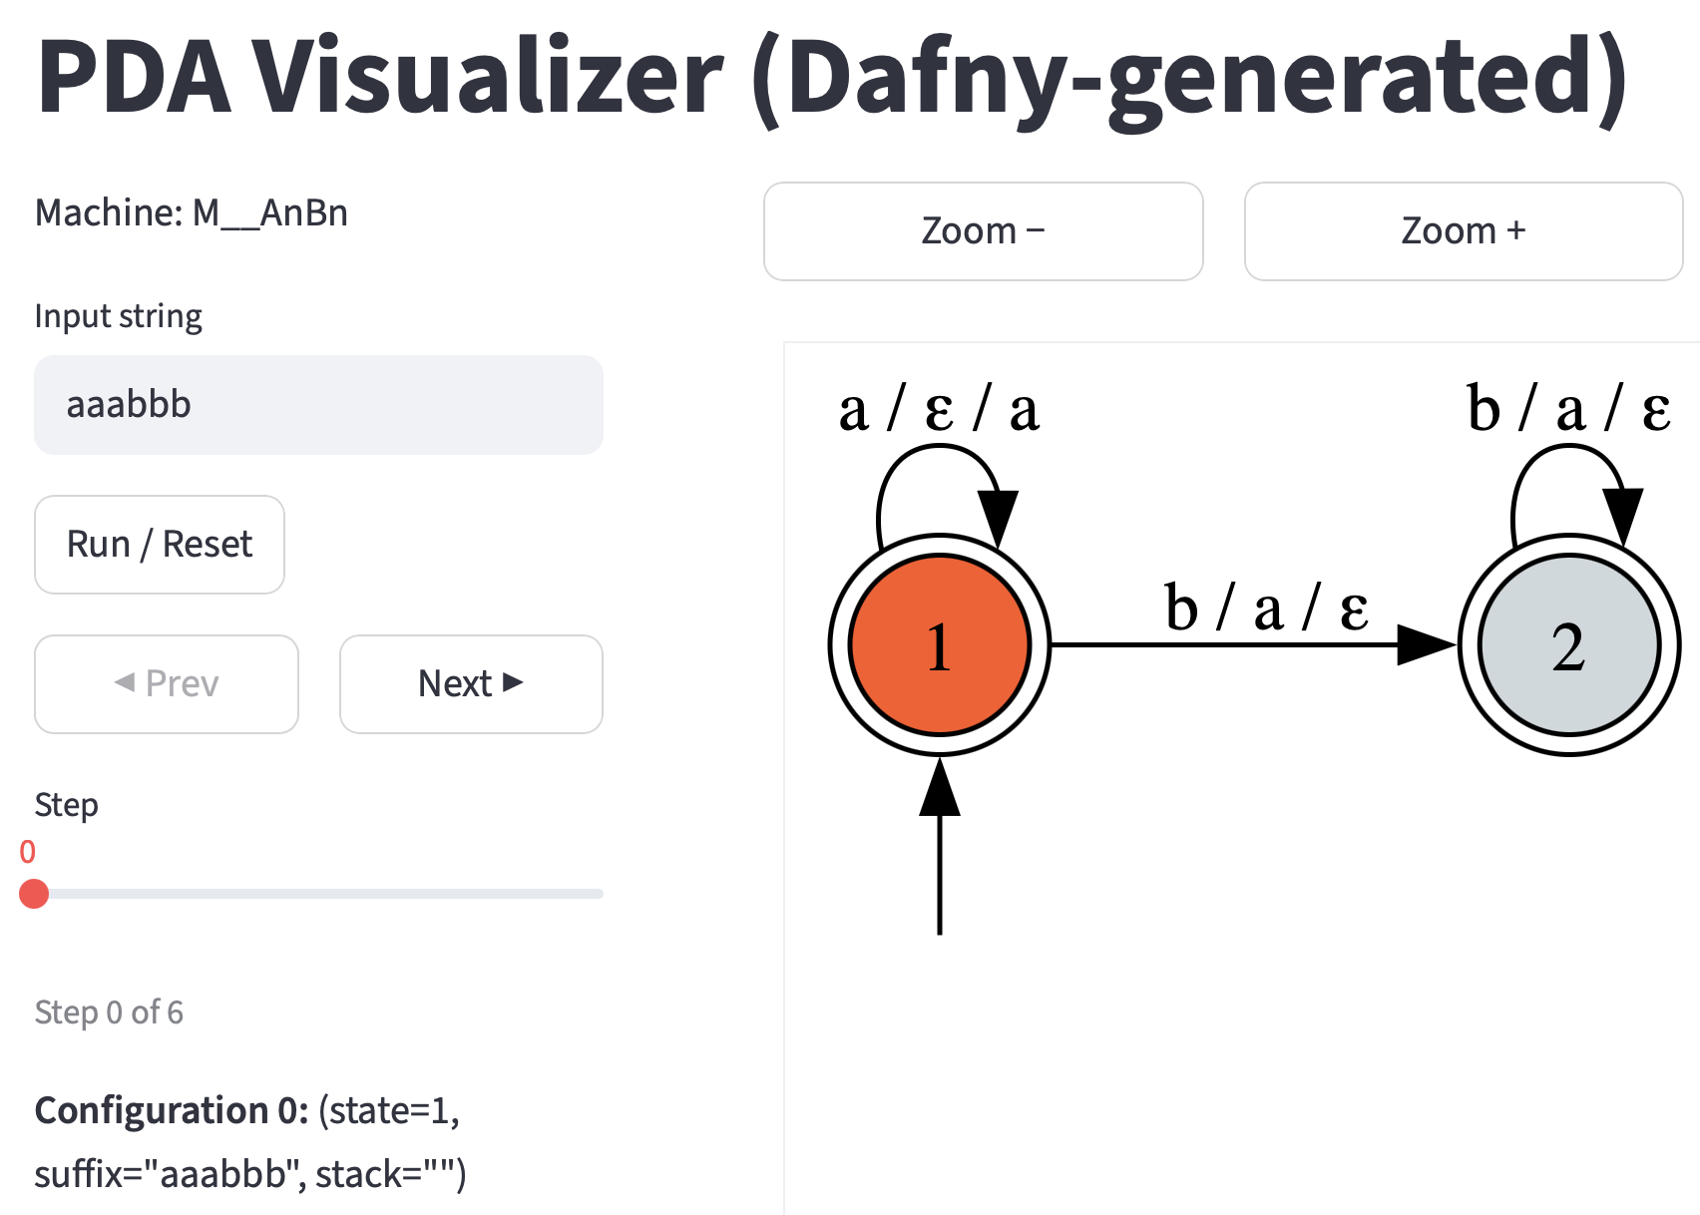

Slide 59


Slide 60


Slide 61


Slide 62
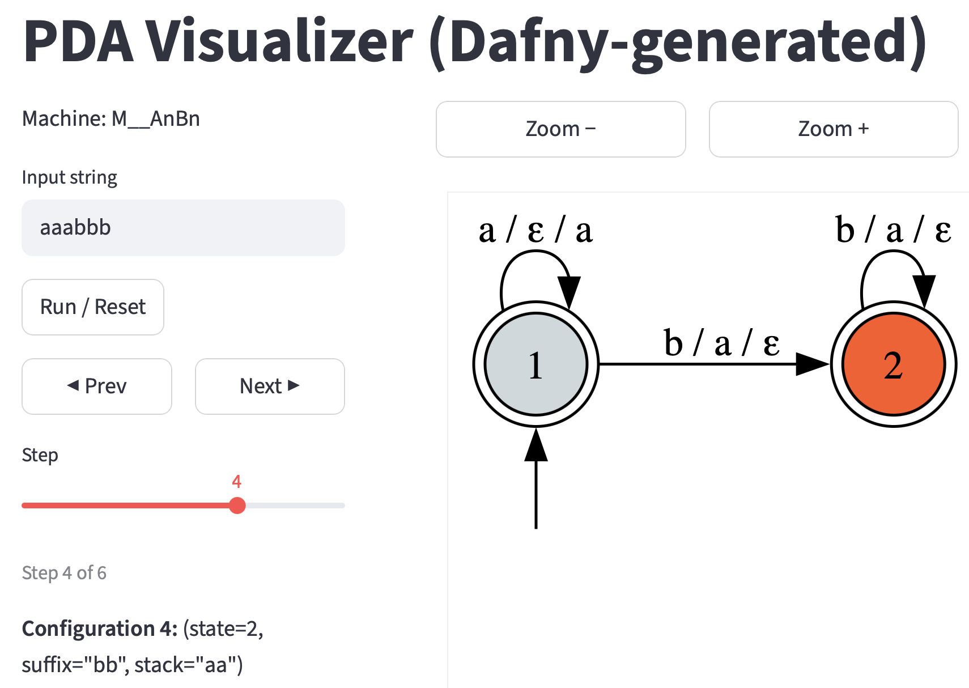

Slide 63
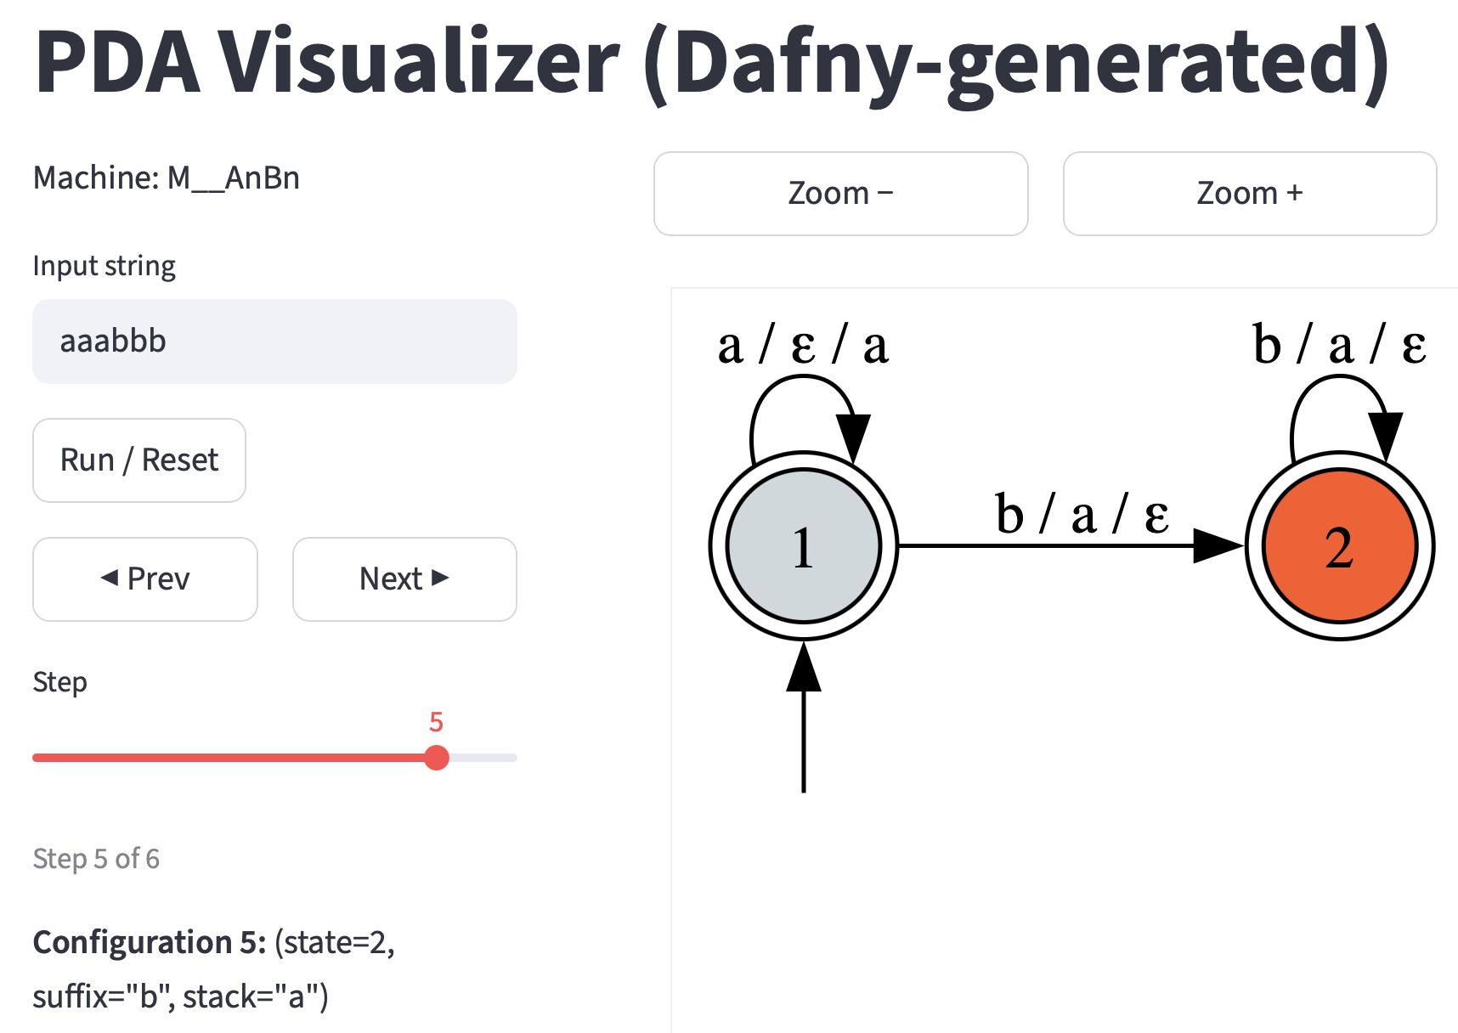

Slide 64
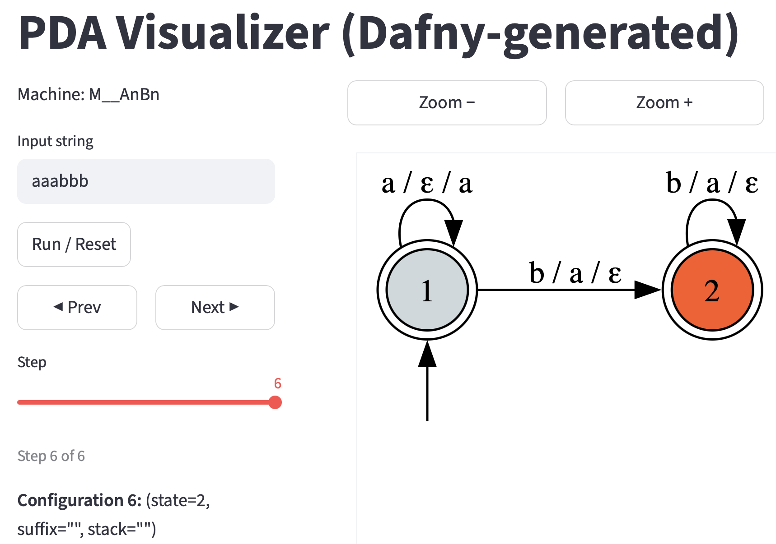


Slide 65
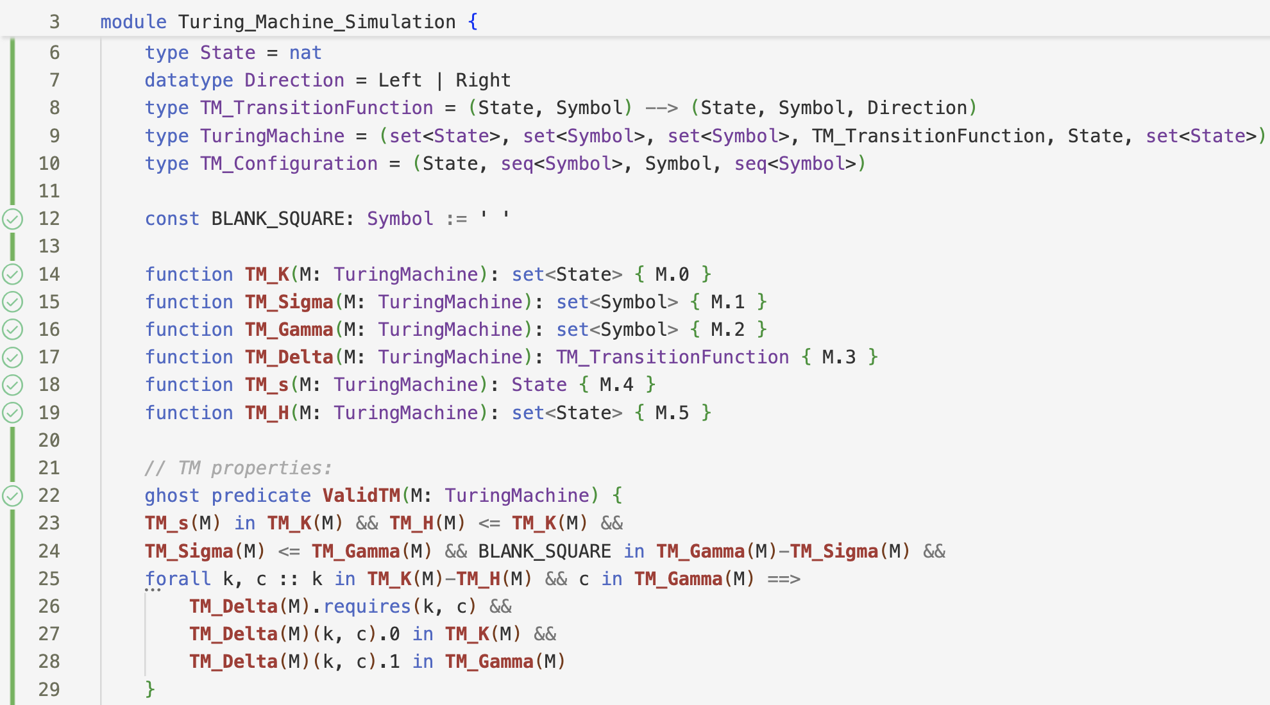

Slide 66


Slide 67


Slide 68


Slide 69


Slide 70


Slide 71



Slide 72



Slide 73


Slide 74
END OF SLIDE DECK

